Slide 1
Book-Minton
CSC318
Group C12: Sport Lover
Group members: Yuanhan Peng, Jiaguan Tang, Chen Wang,
Dongliang Wang, Jiachen Wan, Wenxin Zhang
2022/08/02

Slide 2
Content
01
03
Problem and Idea
Low-Fidelity Prototype Design
02
04
Key Features
High-Fidelity Prototype Design

Slide 3
01
Problem and Idea
2022
CSC318 Group C12 Present

Slide 4
Problem Space
2022
CSC318 Group C12 Present
Find suitable badminton courts
Facilitate the booking process
Provide online platform for badminton fans to share their experience regarding badminton

Slide 5
Process Timeline
High-Fidelity
Prototypes
Usability
Testing
Low-Fidelity
Prototypes
Usability
Testing
Research
Current Design

Slide 6
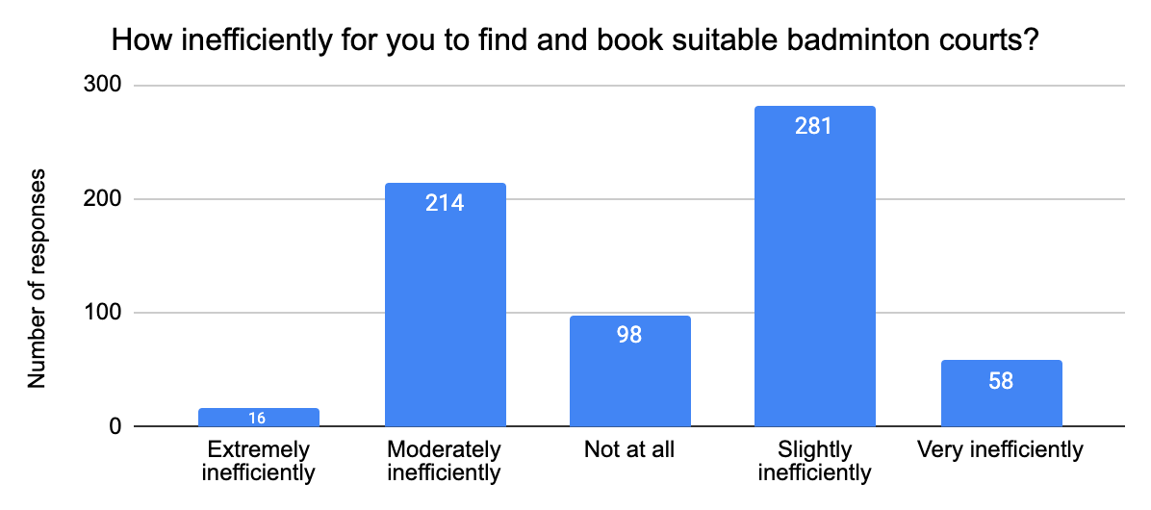
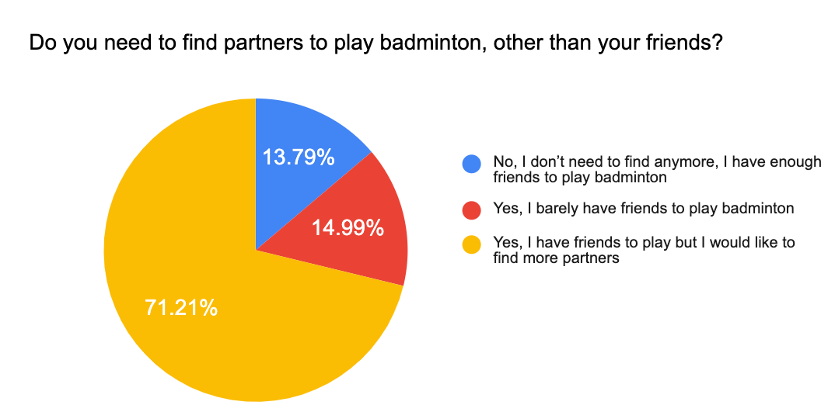
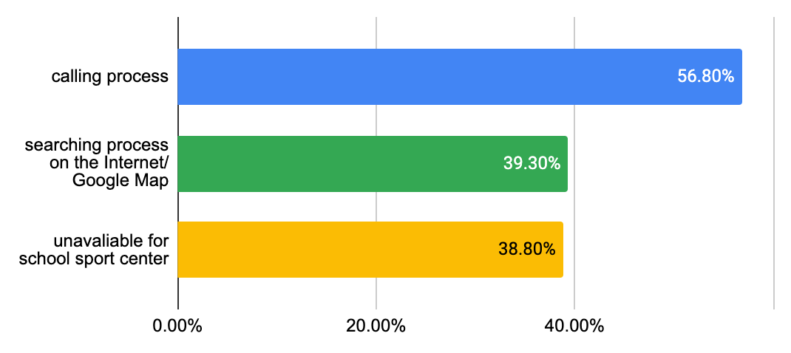
Research Result
672 survey responses; 5 interviews; 2 observations
Booking Methods
Inefficiency Issue
13%
27%
46.8%
In-Person
Online
Phone Call
Social Needs
Problem Faced
Notes:
Hard to find appropriate places around me on the Internet/ Google Map,
Sport Center at school is always full, then have to find places outside school to play
Have to call many possible sport centers/badminton clubs to confirm the time and then book

Slide 7
02
Key Features
2022
CSC318 Group C12 Present

Slide 8
Our key features
App
Find Courts
Book Courts and Pay
Community
Personal Account
Filter, Search
Booking,
Payment
Posting,
Sharing,
Review
Personal Info,
Order History,
Post History

Slide 9
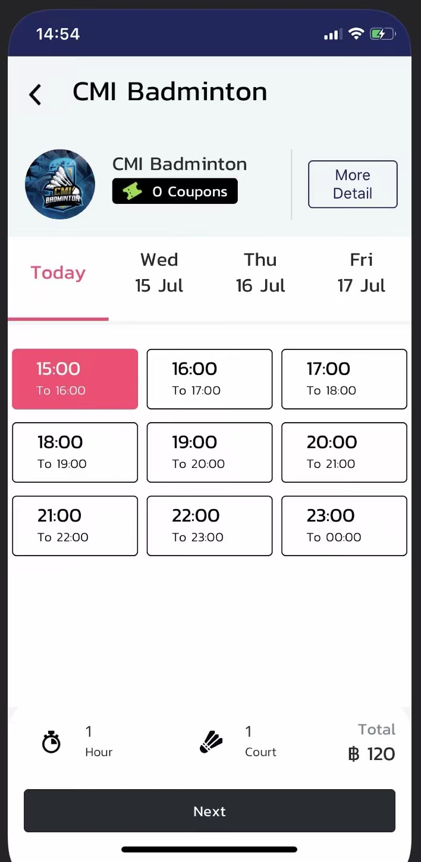
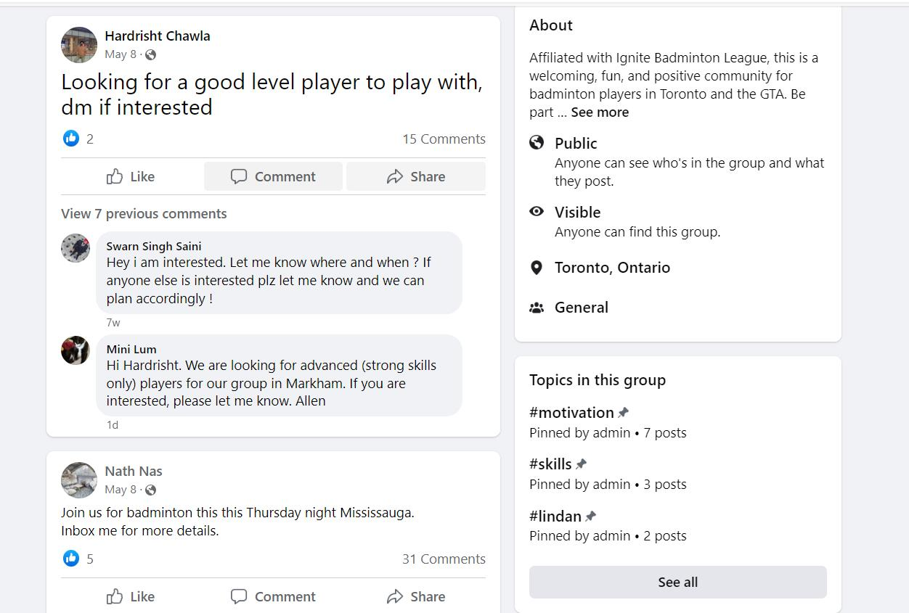
Competitive products
Courtly
An online badminton court booking application
Facebook Group
A place to communicate about shared interests

Slide 10

Our advantages – Combination
A place to communicate about shared interests with others
An online badminton court booking system
=
A unique app about badminton in Toronto

Slide 11
Low-Fidelity Prototype Design
03
2022
CSC318 Group C12 Present
Usability Testing
Updated Prototype

Slide 12
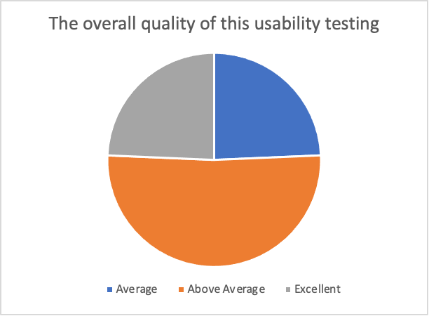
Usability Testing
37 participants
37 post surveys
Problem
Redundant content in home page
The design of timetable and payment methods is not intuitive
Lack of back buttons, scroll bar and submit button

Slide 13
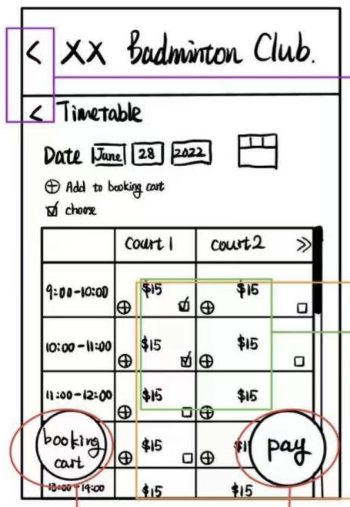
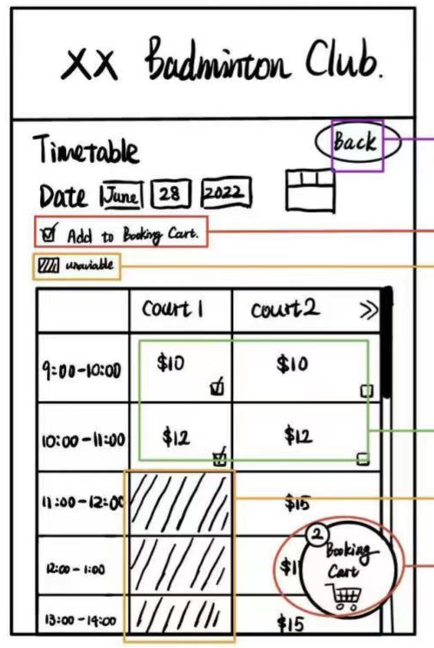
Complex Timetable Page

Slide 14
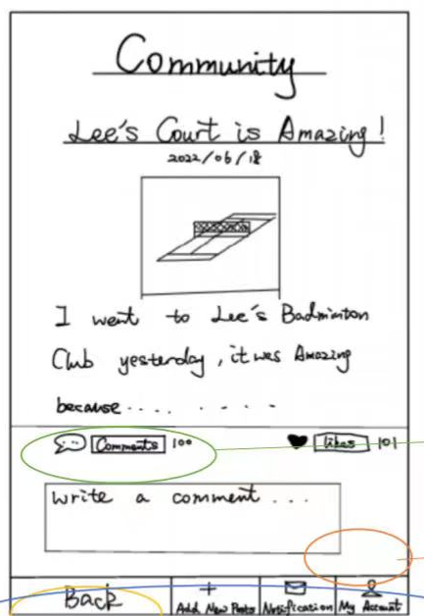
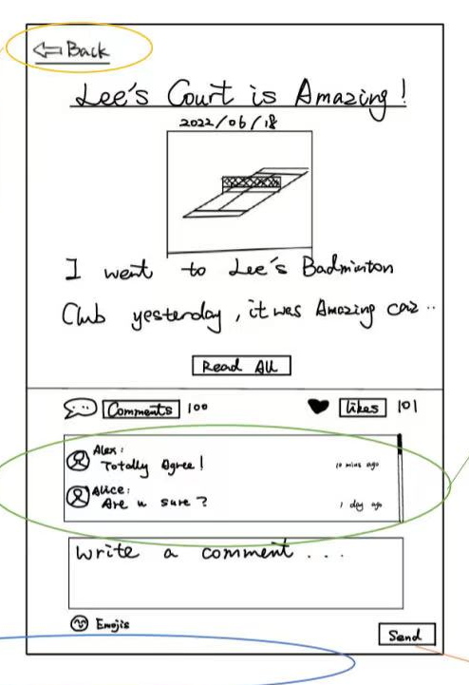
Incomplete Community Page

Slide 15
High-Fidelity Prototype Design
04
2022
CSC318 Group C12 Present
Usability Testing
Updated Prototype

Slide 16
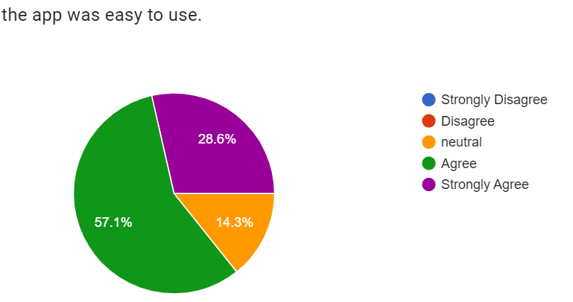
Usability Test
—Anonymous User
Post-study result
10 participants
10 tasks
Pre-study questionnaire & Post-study questionnaire
Problem
APP design inconsistency
Button name unclear
Page content too much
Default value confusion
Negative reaction
“I like how the app is minimalistic. All the features included are essential.”

Slide 17
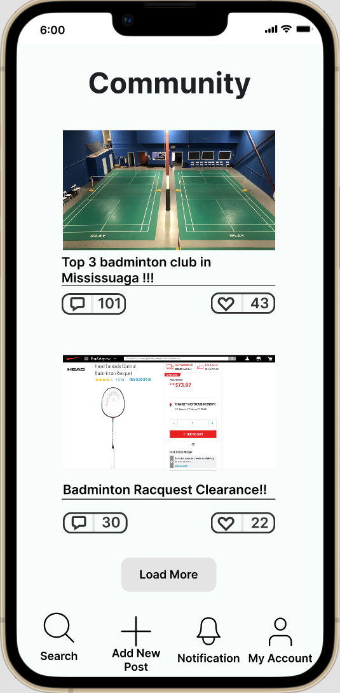
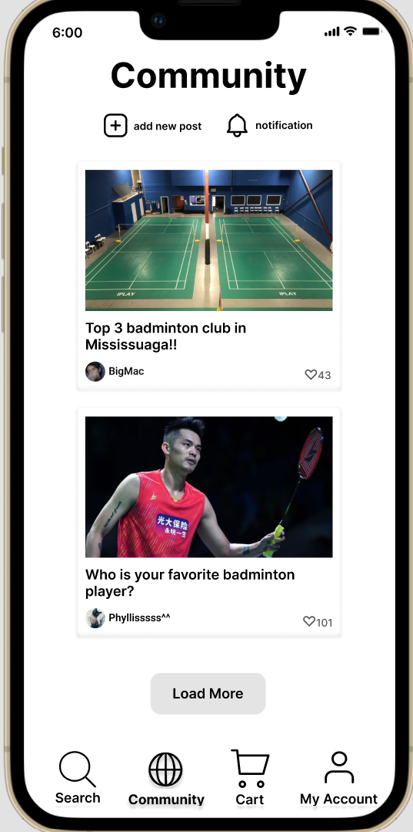
Original Page - Community
Updated Page - Community

Slide 18
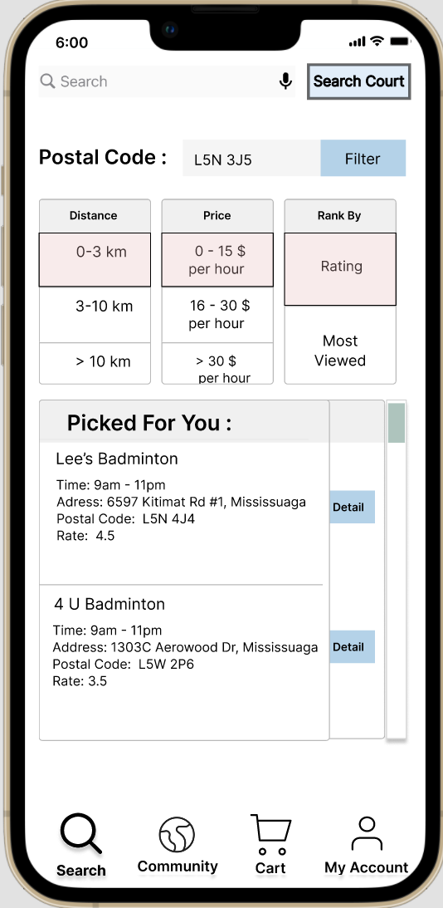
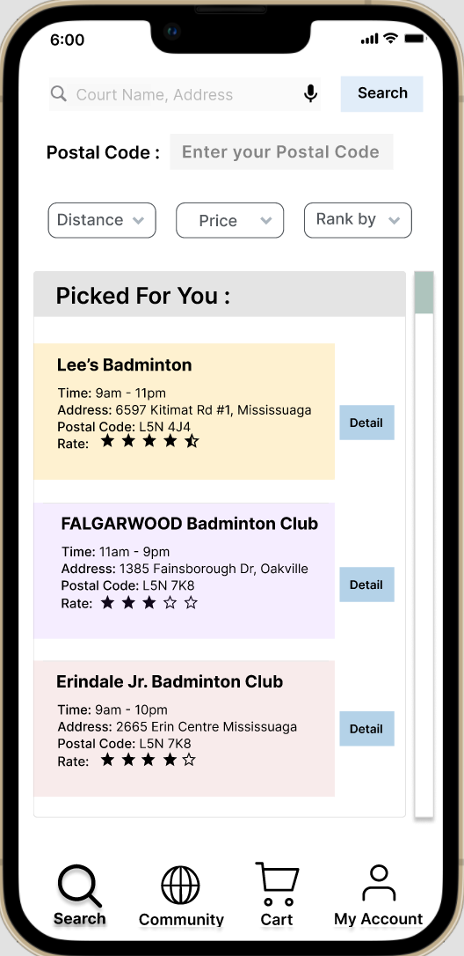
Original Page - Filter
Updated Page - Filter

Slide 19
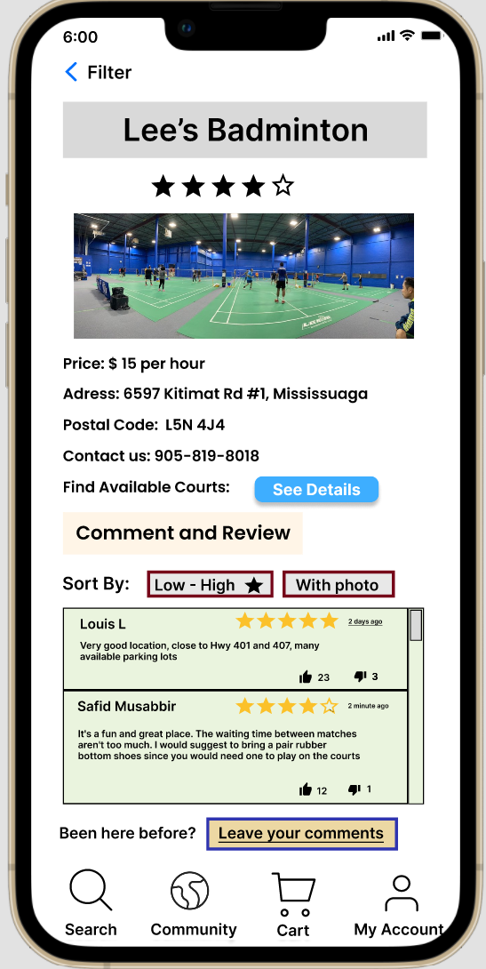
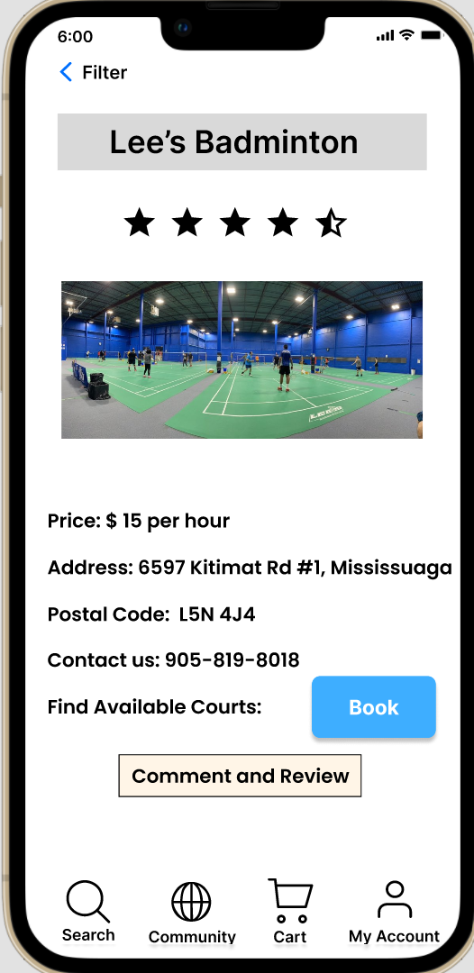
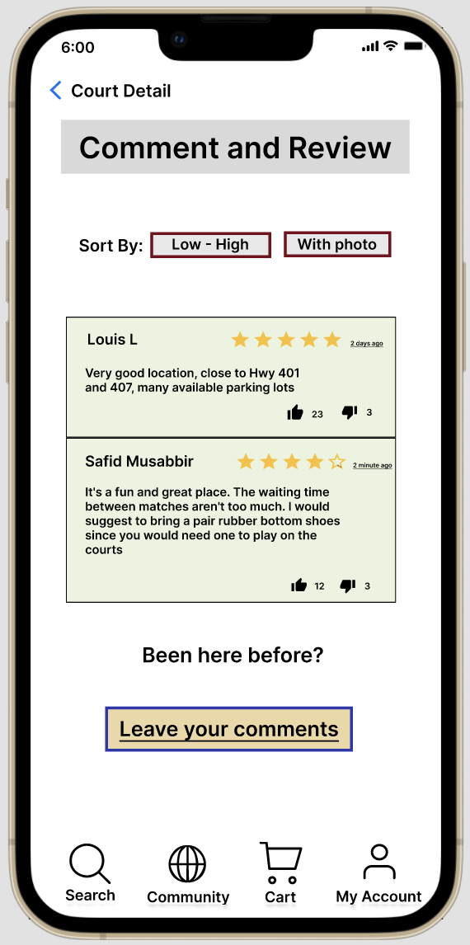
Original Page - Court Detail
Updated Page - Court Detail

Slide 20
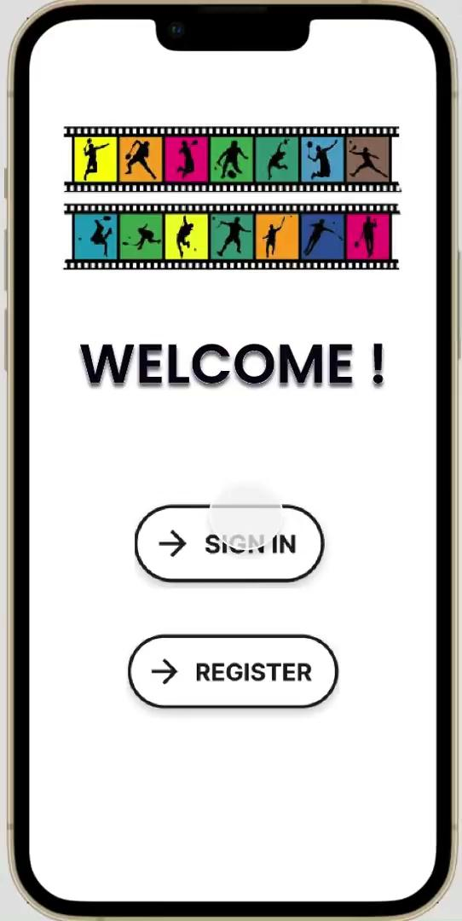
2022
https://drive.google.com/file/d/1K79qbLLC5hCoO1TS8lN81m0QqoFETL5D/view?usp=sharing

Slide 21
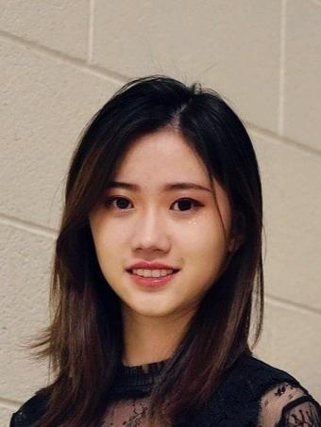
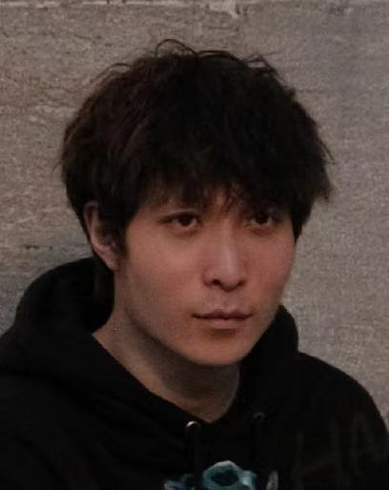
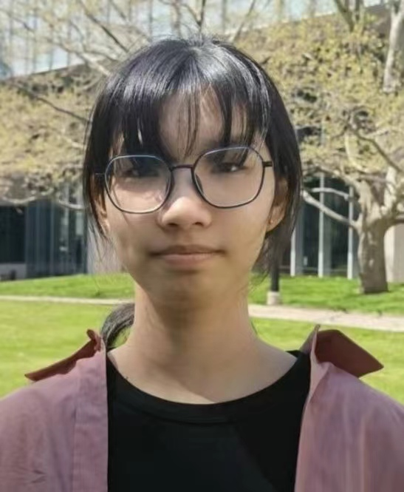
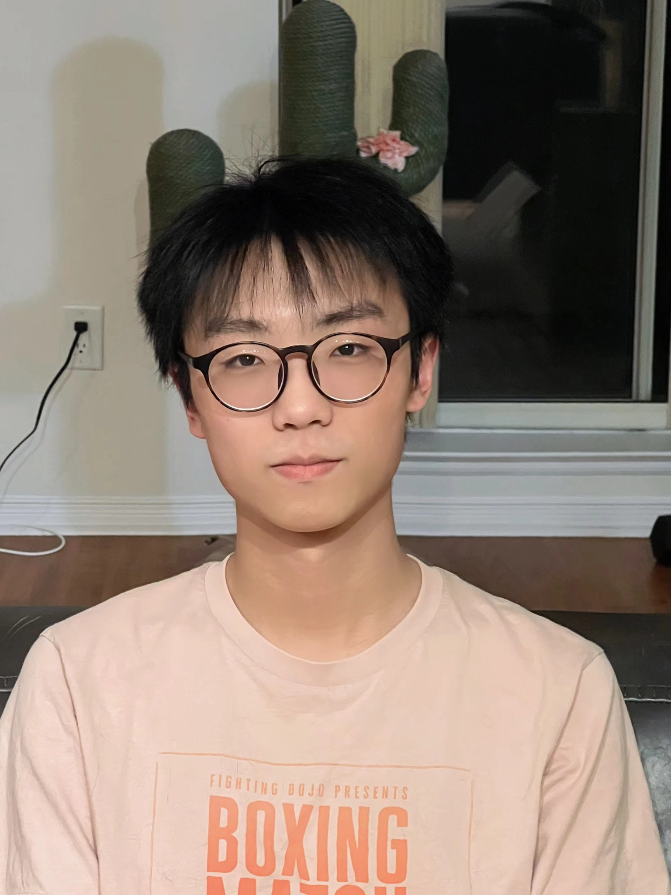
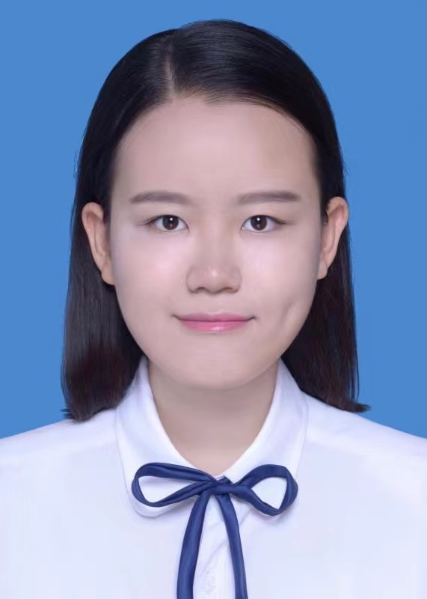
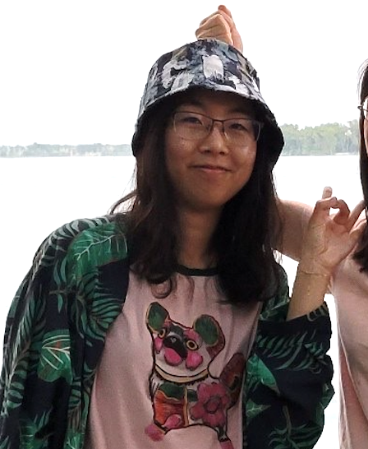
T
E
A
M
M E
M
B
E
R
Yuanhan Peng
4th year, Math &ECO double major, CS minor
Jiaguan Tang
4th year,
CS&STA double major
Dongliang Wang
4th year, CS & STA double major, Math minor
Chen Wang
4th year, CS & STA major, Math minor
Wenxin Zhang
4th year, CS major
Jiachen Wan
4th year, CS & STA double major, Math minor

Slide 22
Thank you!

